Slide 1

Sentiment Analysis & Topic Modeling Mobile Application (SentiScope)
Project members:
Avanish Jha CB.EN.U4ELC20011
Ratneshwar Bharti CB.EN.U4ELC20056
Ravi Gupta CB.EN.U4ELC20057
Rudraksh Singh CB.EN.U4ELC20060
Guided by:
Mr. R Ranjith
Assistant Professor
EEE Dept.

Slide 2

Significance
Data-Driven Decisions: Real-time sentiment insights guide businesses.
Customer Engagement: Address sentiments for better loyalty.
Crisis Prevention: Detect negative trends early.
Tech Integration: Showcasing the synergy of Flutter, Firebase, and ML.

Slide 3

Objective
To understand the demand for sentiment analysis tools.
Real-time feedback and insights for users.
Enhancing business decisions through user feedback analysis.
Creation of a mobile application integrating sentiment analysis and topic modeling.

Slide 4
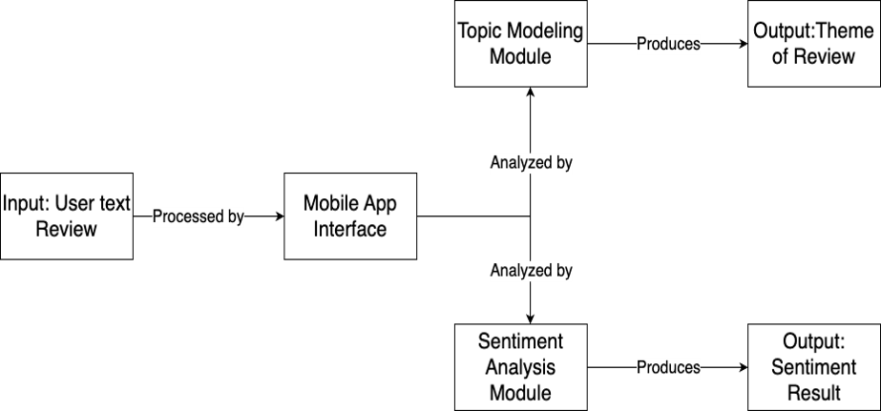
Project Block Diagram

Slide 5
Sentiment Analysis Overview
Definition:
Sentiment analysis extracts opinions from text using natural language processing and machine learning.
Importance:
Customer Insights: Understand opinions on products, services, or brands.
Brand Reputation: Monitor and manage online brand perception.
Market Research: Gain insights into market trends and preferences.
Social Media Monitoring: Track sentiment on social platforms.
Why Sentiment Analysis?
Data-driven Decisions: Informed decisions based on customer feedback.
Customer Engagement: Address concerns promptly.
Competitive Advantage: Adapt strategies based on market sentiments.
Conclusion:
Sentiment analysis provides valuable insights, enabling proactive decision-making and improved customer relations.

Slide 6
Logistic Regression for Sentiment Analysis
Overview:
Logistic Regression is a statistical method used for binary classification.
Despite its name, it's widely applied in sentiment analysis.
Applications:
Customer Feedback: Analyzing reviews and comments for positive or negative sentiment.
Social Media Monitoring: Classifying posts or tweets as positive, negative, or neutral.

Slide 7

Support Vector Machines (SVM):
Overview:
Supervised learning algorithm for classification and regression.
Finds a hyperplane for optimal class separation.
Applications:
Effective for sentiment analysis in text data.
Widely used in image classification and text categorization.

Slide 8

Gradient Boosting:
Overview:
Ensemble learning method that builds a series of weak learners to create a strong learner.
Boosting technique that minimizes errors by combining multiple models.
Applications:
Achieves high accuracy in sentiment analysis tasks.
Commonly used in industry for improved predictions.

Slide 9
Random Forest:
Overview:
Ensemble learning method that builds multiple decision trees and merges them.
Reduces overfitting and increases accuracy by averaging results.
Applications:
Robust performance in sentiment analysis due to its ensemble nature.
Suitable for handling large and diverse datasets.

Slide 10

Data Preparation and Cleaning
Loading the Data:
Mounted Google Drive and loaded a dataset named "Reviews.csv" using Pandas.
Displayed the first few rows and identified the columns in the dataset.
Data Cleaning:
Remove Duplicates:
Deduplicated the dataset to eliminate redundant data.
Handle Missing Values:
Checked for missing values and removed rows with missing text data.
Text Pre-processing:
Convert to Lowercase:
Lowercased the text in the 'Text' column.
Remove Punctuations, Numbers, and Special Characters:
Utilized regular expressions to clean text data.
Tokenize the Text and Remove Stopwords:
Tokenized the text and removed common English stopwords.
Stemming:
Applied stemming to reduce words to their root form for simplicity.

Slide 11

Labeling, Feature Extraction, and Model Loading
Labeling:
Defined sentiment labels based on the 'Score' attribute.
Created a new column 'Sentiment' to represent Positive, Neutral, and Negative sentiments.
Feature Extraction & Splitting the Dataset:
Text Vectorization:
Used TF-IDF vectorization to convert text data into numerical features.
Encoding the Sentiment Labels:
Converted sentiment labels into numerical format for model training.
Model Loading:
Loaded pre-trained machine learning models (Logistic Regression, Gradient Boosting, Random Forest, Support Vector Machine) and vectorizer from saved files.

Slide 12
Model Overview and Evaluation
Model Overview:
Mentioned the use of multiple machine learning models for sentiment analysis.
Highlighted the importance of text pre-processing and feature extraction.
Model Evaluation:
Mentioned the splitting of the dataset into training and test sets.
Highlighted the need for model evaluation using metrics like accuracy, precision, recall, and F1 score.
Conclusion:
Summarized the entire process, from data loading to model loading.
Emphasized the significance of preprocessing and model selection in sentiment analysis.

Slide 13
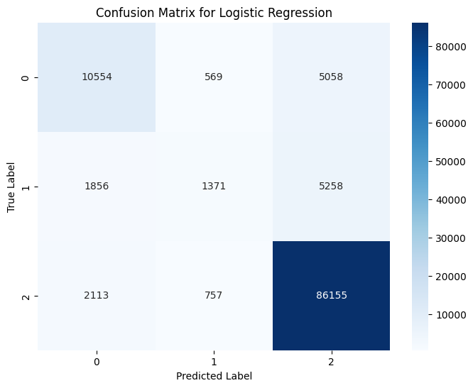

Slide 14


Slide 15
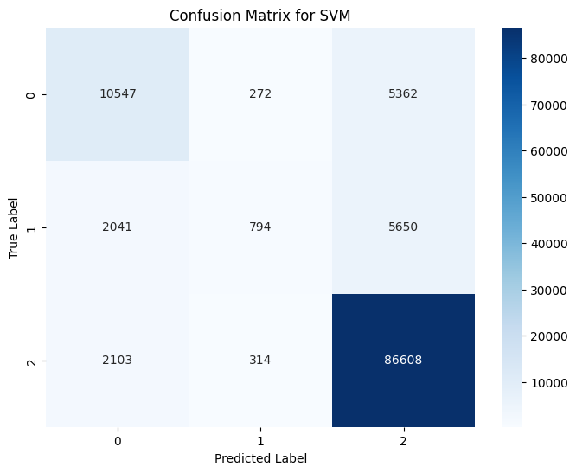

Slide 16


Slide 17
Model Comparison
Accuracy:
Random Forest: 89.50%
Logistic Regression: 86.27%
SVM: 86.15%
Gradient Boosting: 81.91%
Precision:
Random Forest: 90.06%
Logistic Regression: 84.07%
SVM: 83.98%
Gradient Boosting: 80.14%
Recall:
Random Forest: 89.50%
Logistic Regression: 86.27%
SVM: 86.15%
Gradient Boosting: 81.91%
F1-Score:
Random Forest: 88.15%
Logistic Regression: 84.35%
SVM: 83.60%
Gradient Boosting: 76.74%

Slide 18
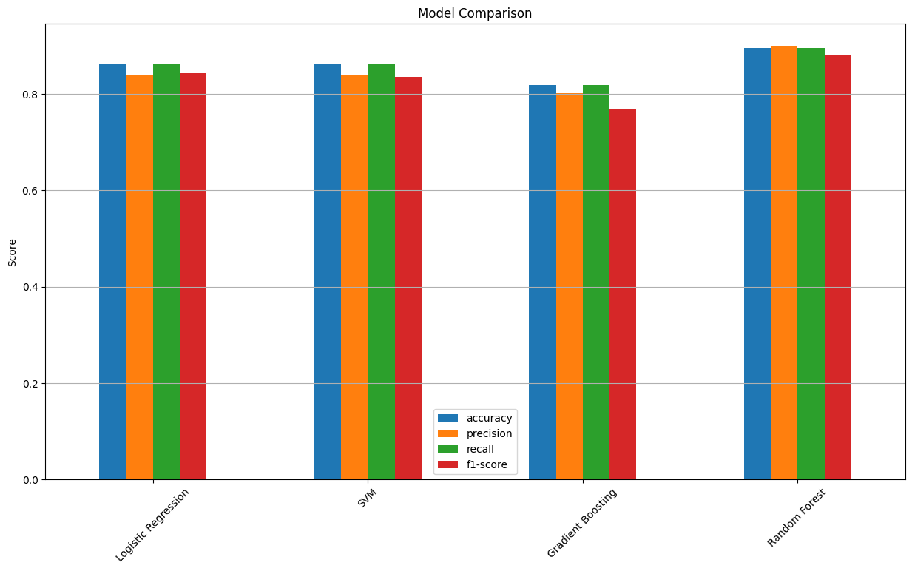

Slide 19
Analysis:
Random Forest emerges as the best-performing model across all metrics.
Logistic Regression and SVM show similar performance.
Gradient Boosting lags behind, especially in precision and recall.
Consider Random Forest for high-precision sentiment analysis.

Slide 20
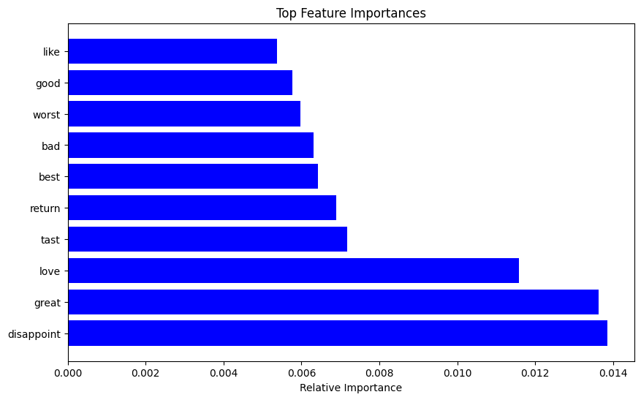
Important Features of Random Forest

Slide 21
Considering LLM
High Computational Resources: Developing LLMs requires significant computational power. Training such models often involves using hundreds or even thousands of high-end GPUs or TPUs for weeks or months, which is extremely expensive and resource-intensive.
Large Dataset Requirements: LLMs are trained on vast datasets, often requiring billions of words. Collecting, storing, and processing such a massive dataset is a daunting task. It requires substantial infrastructure and raises concerns about data quality and representativeness.

Slide 22
Conclusion:
Our sentiment analysis project demonstrates Random Forest's superior performance in accuracy, precision, recall, and F1-score. Logistic Regression and SVM offer a balanced trade-off, while Gradient Boosting lags behind. Visualization of confusion matrices and feature importance aids in model understanding. Recommendations include choosing Random Forest for high-precision analysis and Logistic Regression or SVM for a balanced approach

Slide 23
Time Frame
Month (2023-24) | Task to be Completed
September 2023 | Literature survey
Early October 2023 | Define requirements for sentiment analysis and topic modeling models. Research NLP libraries.
Mid-Late October 2023 | Set up the development environment for model training. Prepare training data.
Early November 2023 | Build and train the sentiment analysis model with prepared data. Evaluate performance.
Mid-November 2023 | Experiment with different Sentiment Analysis Model Classifiers and choose the best one for our project.

Slide 24
Time Frame
Month (2023-24) | Task to be Completed
December 2023 | Fine-tune sentiment analysis model.
Early January 2024 | Creation of Figma UI Design for the overall structure of the app.
Mid-January 2024 | Finalize sentiment analysis model and deploy it on chosen cloud platform (Google Cloud or AWS).
February 2024 | Flutter App Development. Integration to cloud models
March 2024 | Develop and Train Topic Modeling Model
April 2024 | Debugging and Testing of the Application.

Slide 25
References
[1] S. T. K. Shivaprasad and J. Shetty, "Sentiment Analysis of Product Reviews: A Review," NMAM Institute of Technology Nitte, 2017. [Online]. Available: https://doi.org/10.1109/ICICCT.2017.7975207
[2] M. Mashaabi, A. Alotaibi, H. Qudaih, R. Alnashwan, and H. Al-Khalifa, "Natural Language Processing in Customer Service: A Systematic Review," King Saud University, Riyadh, 2022. [Online]. Available: https://doi.org/10.48550/arXiv.2212.09523
[3] G. Kaur and A. Sharma, "Comparison of Different Machine Learning Algorithms for Sentiment Analysis," Symbiosis International University, Pune, 2022. [Online]. Available: https://doi.org/10.1109/ICSCDS53736.2022.9760846
[4] D. Khurana, A. Koli, K. Khatter, and S. Singh, "Natural language processing: state of the art, current trends, and challenges," 2022. [Online]. Available: https://doi.org/10.1007/s11042-022-13428-4
[5] G. Papadia, M. Pacella, M. Perrone, and V. Giliberti, "A Comparison of Different Topic Modeling Methods through a Real Case Study of Italian Customer Care," Algorithms, vol. 16, no. 94, 2023. [Online]. Available: https://doi.org/10.3390/a16020094

Slide 26
[6] P. Dhanalakshmi, G. A. Kumar, B. S. Satwik, K. Sreeranga, A. T. Sai and G. Jashwanth, "Sentiment Analysis Using VADER and Logistic Regression Techniques," 2023 International Conference on Intelligent Systems for Communication, IoT and Security (ICISCoIS), Coimbatore, India, 2023, pp. 139-144, doi: 10.1109/ICISCoIS56541.2023.10100565.
[7] Wankhade, M., Rao, A.C.S. & Kulkarni, C. A survey on sentiment analysis methods, applications,and challenges. Artif Intell Rev 55, 5731–5780 (2022). https://doi.org/10.1007/s10462-022-10144-1

